Slide 1
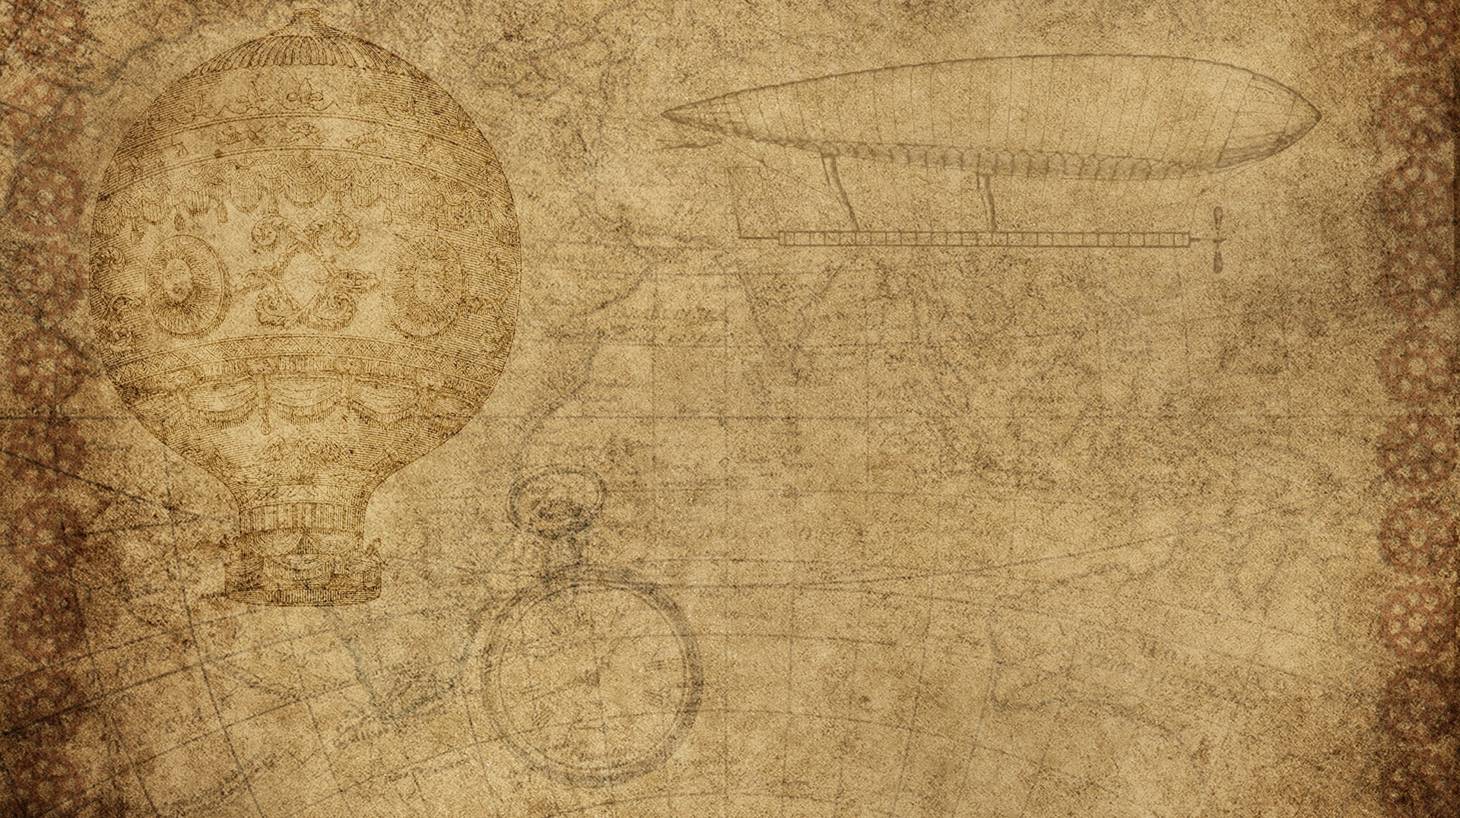

Human Gait Presentation

Slide 2

IDEA
As we know Activity Recognition is useful in many fields as pervasive healthcare and surveillance, The recognition of human gait can be useful to identify the characteristics of the places or physical space such as walking, walking downstairs …etc.

Slide 3
Cont'
In this Project a method of recognizing gait activities using acceleration data obtained from a smartphone, the acceleration signal were segmented based on the strides (Peaks and Valley ) then Feature vector of the segmented signals was extracted, Which was used to train five Classifier Using:
-Support Vector Machine
- Decision Tree
- Random Forest
-Naive Bayes
- K-Nearest neighbors

Slide 4
Dataset
It was collected from data consist of six Activities [ jogging ,stand, walking, stair up, stair down, sit]
Where each activity has its own accelerometer data and time stamps

Slide 5
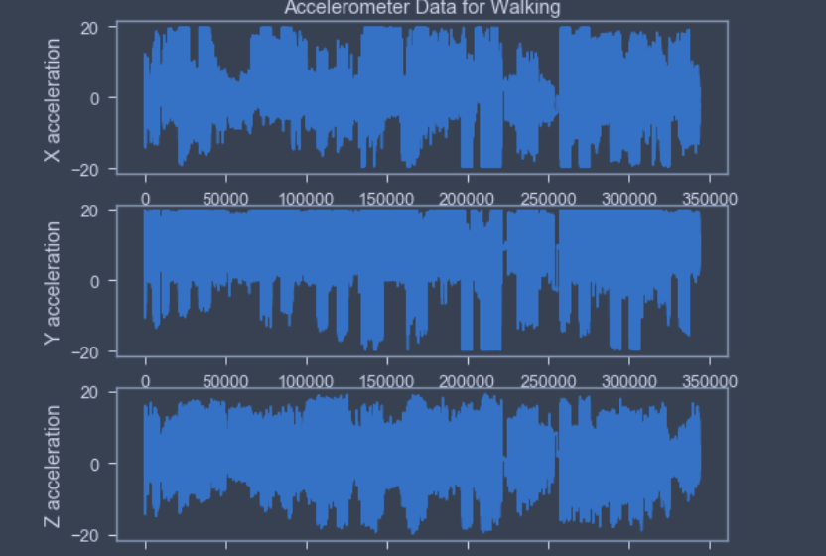
Method
Phase 1: Preprocessing
1-Load Data

Slide 6
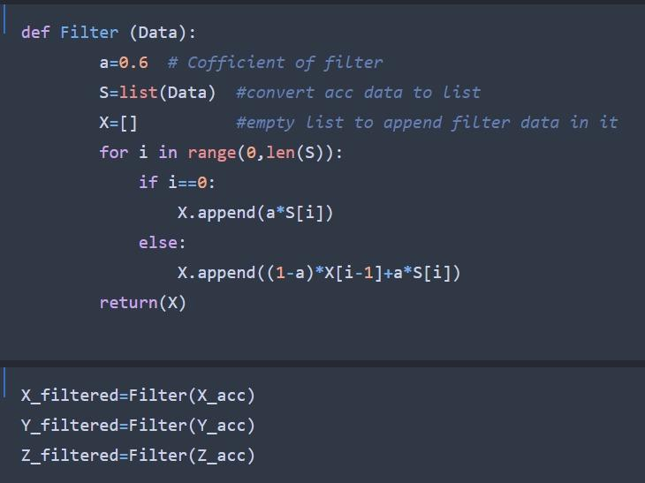
Method
Phase 1: Preprocessing
2-Appling Low_ pass Filter

Slide 7
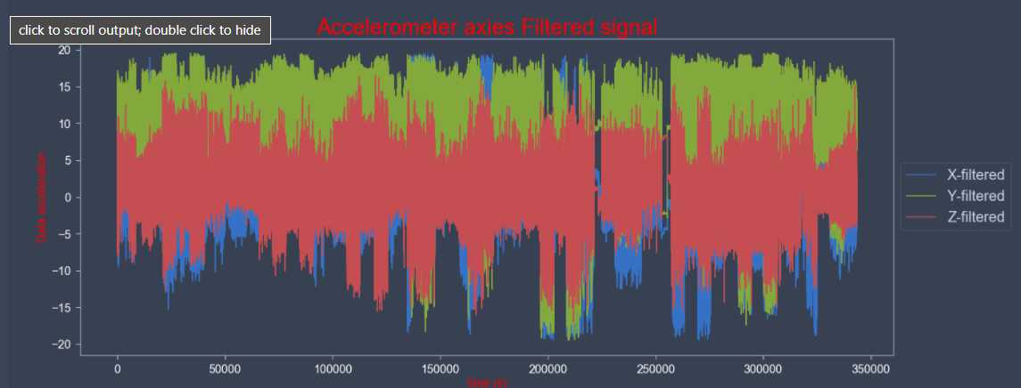
Method
Phase 1: Preprocessing
2-Appling Low_ pass Filter

Slide 8
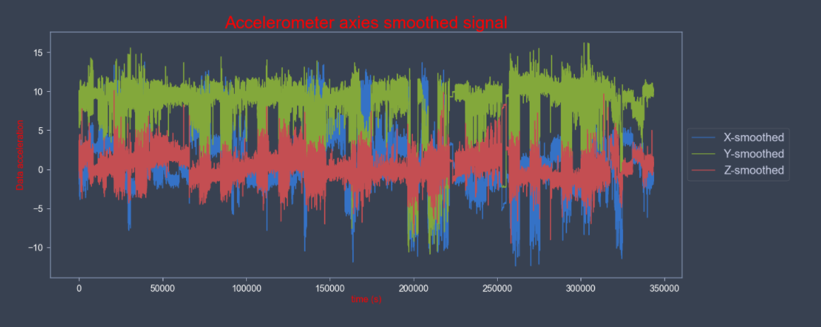
Method
Phase 1: Preprocessing
3-Applying smoothing

Slide 9
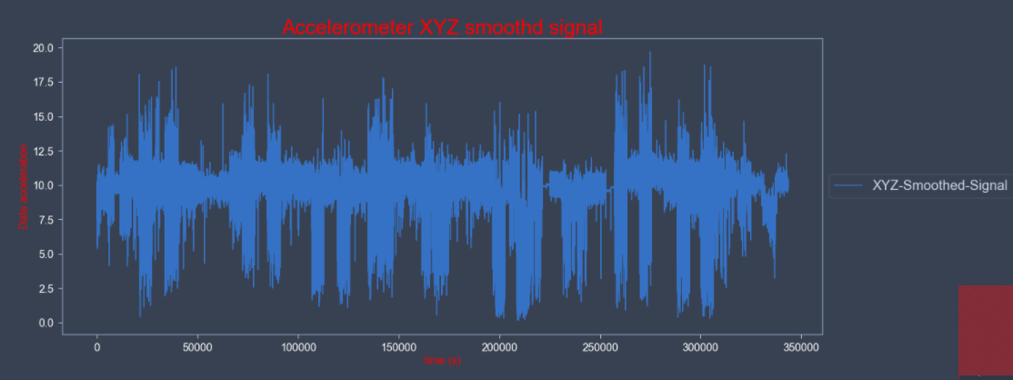
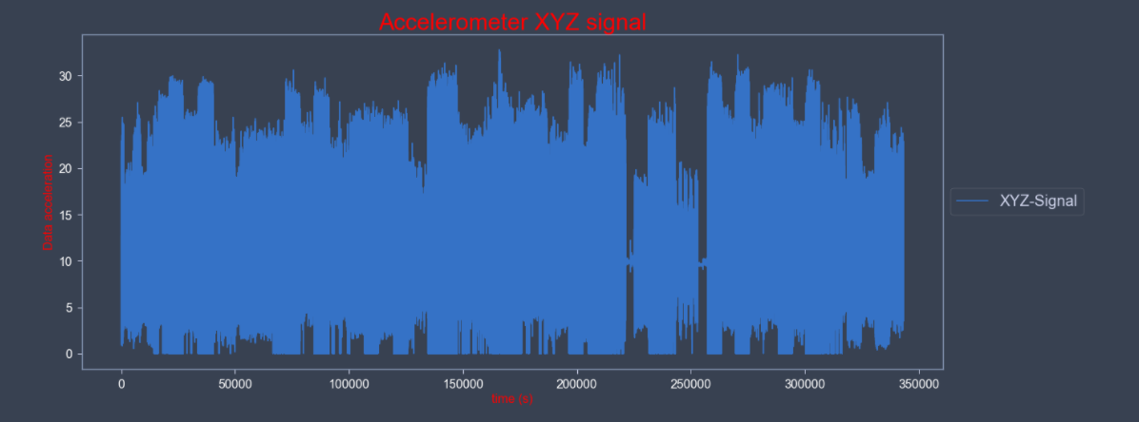
Method
Phase 1: Preprocessing
4-Applying XYZ

Slide 10
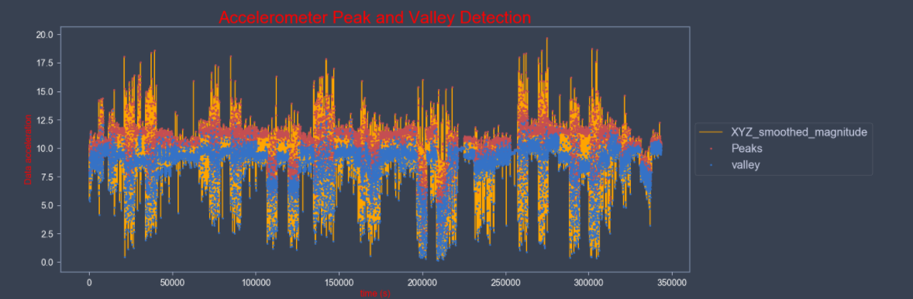
Method
Phase 1: Preprocessing
5-Detection of Peaks and Valleys

Slide 11
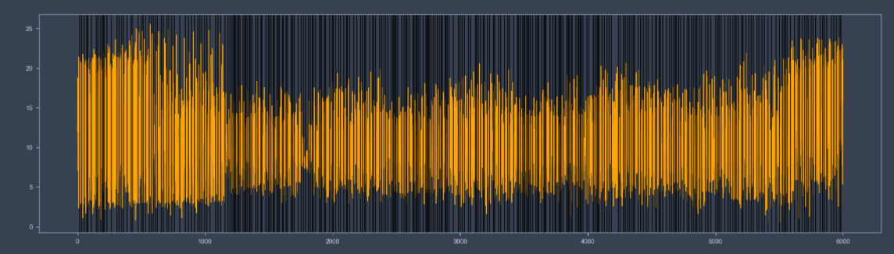
Method
Phase 1: Preprocessing
6-Segmentation

Slide 12
Method
Phase 2: Feature extraction
1-Peak Height
2-Mean
3-Peak width
4-Standard Division
5-Data Frame for feature

Slide 13
Method
Phase 3: Classification
1-Train_Test_Split
2-Feature Scaling & Label encoding
3-Algorithms Used:
Support Vector machine
K-Nearest Neighbors
Random forest
Decision Tree
Naive Bayes

Slide 14
Confusion Matrix & Cross Validation:
For each algorithm, we have used Cross-validation in all algorithms to train and testing data to estimate the skill of machine learning models.
In Cross-validation for each data using a certain algorithm there is a resampling procedure used to evaluate machine learning models on a limited data sample and generates a score for each sample.

Slide 15
Results and conclusions:
To Calculate accuracy we use the accuracy score function from metrics in sklearn
Algorithm | Accuracy
SVC | 0.81
Decision Tree | 0.81
Random forest | 0.82
KNN | 0.83
Naive Bayes | 0.76

Slide 16
Test model with new data:
Algorithm | Accuracy
SVC | 0.32
Decision Tree | 0.31
Random forest | 0.3
KNN | 0.3
Naive Bayes | 0.33

Slide 17
Challenges:
We Faced a lot of challenges as the paper of Recognition of Gait Activities Using Acceleration Data from A Smartphone and A Wearable Device. Has many functions with no identification for it like Power( ), Forward Direction, segmenting, power for feature extraction.
Also we didn’t find a perfect dataset, So we started collecting the dataset manually from different accelerometers read for activity and it was so small.

